Slide 1

APEX INSTITUTE OF TECHNOLOGY
DEPARTMENT OF COMPUTER SCIENCE & ENGINEERING
Statistics for Data Science(14CSHB-233)
Faculty: Prof. (Dr.) Madan Lal Saini(E13485)
Lecture – 1
Descriptive Statistics
DISCOVER . LEARN . EMPOWER

Slide 2
Statistics for Data Science : Course Objectives
COURSE OBJECTIVES
The Course aims to:
To equip students with the skills to summarize and interpret data using descriptive statistics and visualization techniques.
To develop a foundational understanding of probability and its applications in data science.
To enable students to perform hypothesis testing and construct confidence intervals for statistical inference.
To teach students how to build and assess linear and logistic regression models for predictive analysis.
To provide hands-on experience with statistical software for data manipulation, analysis, and visualization.

Slide 3
COURSE OUTCOMES
On completion of this course, the students shall be able to:-
CO1 | Summarize and describe the main features of a dataset using measures such as mean, median, mode, variance, and standard deviation, as well as graphical representations like histograms, box plots, and scatter plots.
CO2 | Understand of probability theory, including concepts such as random variables, probability distributions, and the law of large numbers, enabling them to model and reason about uncertainty in data.
CO3 | Apply/perform statistical inference, including hypothesis testing, confidence interval estimation, and p-value computation, to draw valid conclusions from sample data about larger populations.
CO4 | Apply linear and logistic regression techniques to identify relationships between variables, make predictions, and evaluate model performance.
CO5 | Utilize statistical software tools to perform data analysis, including data cleaning, transformation, visualization, and implementing various statistical methods.

Slide 4
Unit-1 Syllabus
Unit-1 | Descriptive Statistics
Descriptive Statistics and Bayes Theorem | Descriptive statistics basics Mean, median, and mode Standard deviation Use of the central tendency measures Bayes Theorem
Data Visualization | Types of visualization Calculation and interpretation of graphs, plot, and measures

Slide 5
SUGGESTIVE READINGS
TEXT BOOKS:
T1. Hastie, Trevor, et al., The elements of statistical learning. Vol. 2. No. 1. New York: Publisher: Springer, Edition: Second Edition (2009), ISBN: 978-0387848570
T2. Montgomery, Douglas C., and George C. Runger. Applied statistics and probability for engineers. John Wiley & Sons, 2010.
T3. Probability and Statistics The Science of Uncertainty Second Ed., Michael J. Evans and Jeffrey S. Rosenthal.
REFERENCE BOOKS:
R1. Practical Statistics for Data Scientists: 50 Essential Concepts, Authors: Peter Bruce, et al, Publisher: O'Reilly Media, Edition: Second Edition (2020), ISBN: 978-1492072942
R2. An Introduction to Statistical Learning: with Applications in R, Authors: Gareth James, et al, Publisher: Springer, Edition: Second Edition (2021), ISBN: 978-1071614174
R3. Think Stats: Exploratory Data Analysis in Python, Author: Allen B. Downey, Publisher: O'Reilly Media, Publication Year: 2014 (2nd Edition), ISBN: 978-1491907337

Slide 6
Table of Contents
Introduction to Statistics
Measures of Central Tendency
Mean, Median, Mode
Examples
Solved Questions

Slide 7
3. Descriptive Statistics
Describing data with tables and graphs
(quantitative or categorical variables)
Numerical descriptions of center, variability, position (quantitative variables)
Bivariate descriptions (In practice, most studies have several variables)

Slide 8
1. Tables and Graphs
Frequency distribution: Lists possible values of variable and number of times each occurs
Example: Student survey (n = 60) www.stat.ufl.edu/~aa/social/data.html
“political ideology” measured as ordinal variable with 1 = very liberal, …, 4 = moderate, …, 7 = very conservative

Slide 9
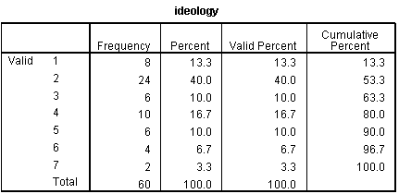

Slide 10
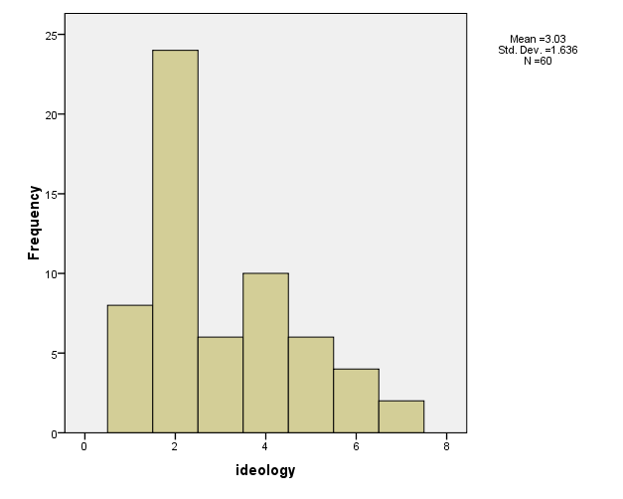
Histogram: Bar graph of frequencies or percentages

Slide 11
Shapes of histograms (for quantitative variables)
Bell-shaped (IQ, SAT, political ideology in all U.S. )
Skewed right (annual income, no. times arrested)
Skewed left (score on easy exam)
Bimodal (polarized opinions)
Ex. GSS data on sex before marriage in Exercise 3.73: always wrong, almost always wrong, wrong only sometimes, not wrong at all
category counts 238, 79, 157, 409
Notes:
Draw on board, perhaps add U-shaped

Slide 12
Stem-and-leaf plot (John Tukey, 1977)
Example: Exam scores (n = 40 students)
Stem Leaf
3 6
4
5 37
6 235899
7 011346778999
8 00111233568889
9 02238
Notes:
Due to John Tukey, EDA, 1977

Slide 13
2.Numerical descriptions
Let y denote a quantitative variable, with observations y₁ , y₂ , y₃ , … , y_{n}
a. Describing the center
Median: Middle measurement of ordered sample
Mean:

Slide 14
Example: Annual per capita carbon dioxide emissions (metric tons) for n = 8 largest nations in population size
Bangladesh 0.3, Brazil 1.8, China 2.3, India 1.2, Indonesia 1.4, Pakistan 0.7, Russia 9.9, U.S. 20.1
Ordered sample:
Median =
Mean =
Notes:
Median– average two middle measurements when n even

Slide 15
Example: Annual per capita carbon dioxide emissions (metric tons) for n = 8 largest nations in population size
Bangladesh 0.3, Brazil 1.8, China 2.3, India 1.2, Indonesia 1.4, Pakistan 0.7, Russia 9.9, U.S. 20.1
Ordered sample: 0.3, 0.7, 1.2, 1.4, 1.8, 2.3, 9.9, 20.1
Median =
Mean =
Notes:
Median– average two middle measurements when n even

Slide 16
Example: Annual per capita carbon dioxide emissions (metric tons) for n = 8 largest nations in population size
Bangladesh 0.3, Brazil 1.8, China 2.3, India 1.2, Indonesia 1.4, Pakistan 0.7, Russia 9.9, U.S. 20.1
Ordered sample: 0.3, 0.7, 1.2, 1.4, 1.8, 2.3, 9.9, 20.1
Median = (1.4 + 1.8)/2 = 1.6
Mean = (0.3 + 0.7 + 1.2 + … + 20.1)/8 = 4.7
Notes:
Median– average two middle measurements when n even

Slide 17
Properties of mean and median
For symmetric distributions, mean = median
For skewed distributions, mean is drawn in direction of longer tail, relative to median
Mean valid for interval scales, median for interval or ordinal scales
Mean sensitive to “outliers” (median often preferred for highly skewed distributions)
When distribution symmetric or mildly skewed or discrete with few values, mean preferred because uses numerical values of observations
Notes:
Mean = center of gravity of data. Mode another measure, appropriate for all scales

Slide 18
Examples:
New York Yankees baseball team, 2006
mean salary = $7.0 million
median salary = $2.9 million
How possible? Direction of skew?
Give an example for which you would expect
mean < median

Slide 19
b. Describing variability
Range: Difference between largest and smallest observations
(but highly sensitive to outliers, insensitive to shape)
Standard deviation: A “typical” distance from the mean
The deviation of observation i from the mean is
Notes:
Draw picture showing insensitivity of range to shape

Slide 20
The variance of the n observations is
The standard deviation s is the square root of the variance,

Slide 21
Example: Political ideology
For those in the student sample who attend religious services at least once a week (n = 9 of the 60),
y = 2, 3, 7, 5, 6, 7, 5, 6, 4
For entire sample (n = 60), mean = 3.0, standard deviation = 1.6, tends to have similar variability but be more liberal

Slide 22
Properties of the standard deviation:
s ≥ 0, and only equals 0 if all observations are equal
s increases with the amount of variation around the mean
Division by n - 1 (not n) is due to technical reasons (later)
s depends on the units of the data (e.g. measure euro vs $)
Like mean, affected by outliers
Empirical rule: If distribution is approx. bell-shaped,
about 68% of data within 1 standard dev. of mean
about 95% of data within 2 standard dev. of mean
all or nearly all data within 3 standard dev. of mean

Slide 23
Example: SAT with mean = 500, s = 100
(sketch picture summarizing data)
Example: y = number of close friends you have
GSS: The variable ‘frinum’ has mean 7.4, s = 11.0
Probably highly skewed: right or left?
Empirical rule fails; in fact, median = 5, mode=4
Example: y = selling price of home in Syracuse, NY.
If mean = $130,000, which is realistic?
s = 0, s = 1000, s = 50,000, s = 1,000,000
Notes:
Show picture of SAT

Slide 24
c. Measures of position
p^{th} percentile: p percent of observations below it, (100 - p)% above it.
p = 50: median
p = 25: lower quartile (LQ)
p = 75: upper quartile (UQ)
Interquartile range IQR = UQ - LQ
Notes:
Draw picture

Slide 25
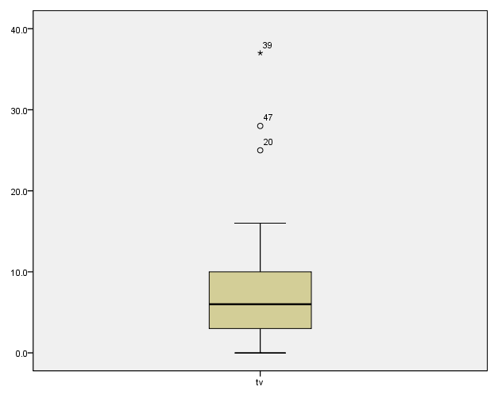
Quartiles portrayed graphically by box plots
(John Tukey) Example: weekly TV watching for n=60 from student survey data file, 3 outliers

Slide 26
Box plots have box from LQ to UQ, with median marked. They portray a five-number summary of the data:
Minimum, LQ, Median, UQ, Maximum
except for outliers identified separately
Outlier = observation falling
below LQ – 1.5(IQR)
or above UQ + 1.5(IQR)
Ex. If LQ = 2, UQ = 10, then IQR = 8 and outliers above 10 + 1.5(8) = 22

Slide 27
3. Bivariate description
Usually we want to study associations between two or more variables (e.g., how does number of close friends depend on gender, income, education, age, working status, rural/urban, religiosity…)
Response variable: the outcome variable
Explanatory variable(s): defines groups to compare
Ex.: number of close friends is a response variable, while gender, income, … are explanatory variables
Response var. also called “dependent variable”
Explanatory var. also called “independent variable”

Slide 28
Summarizing associations:
Categorical var’s: show data using contingency tables
Quantitative var’s: show data using scatterplots
Mixture of categorical var. and quantitative var. (e.g., number of close friends and gender) can give numerical summaries (mean, standard deviation) or side-by-side box plots for the groups
Ex. General Social Survey (GSS) data
Men: mean = 7.0, s = 8.4
Women: mean = 5.9, s = 6.0
Shape? Inference questions for later chapters?

Slide 29
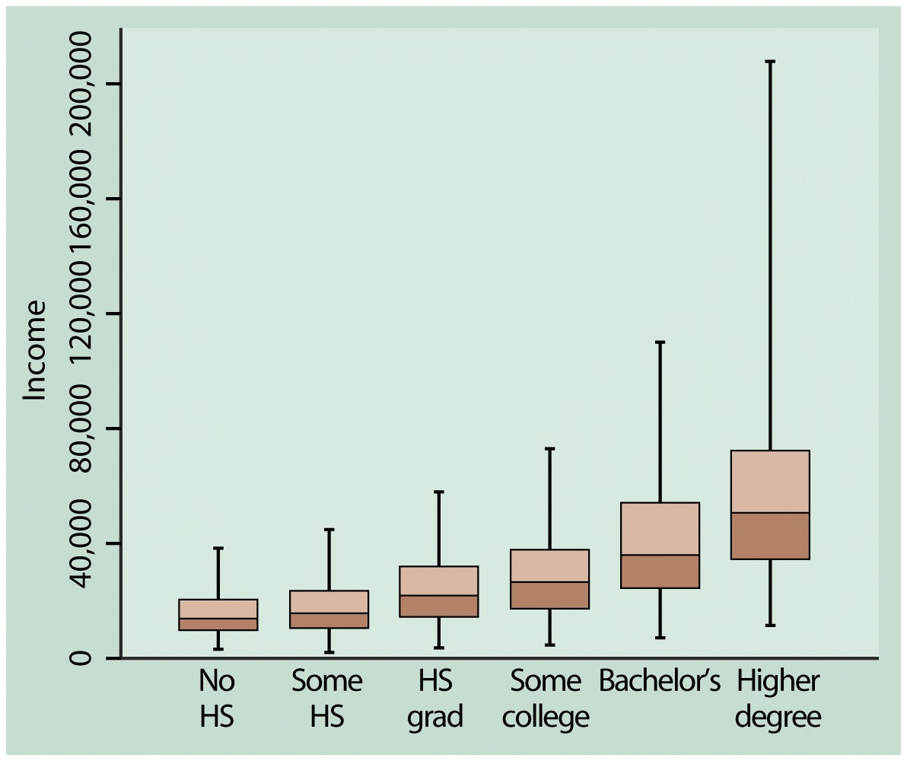
Example: Income by highest degree

Slide 30
Contingency Tables
Cross classifications of categorical variables in which rows (typically) represent categories of explanatory variable and columns represent categories of response variable.
Counts in “cells” of the table give the numbers of individuals at the corresponding combination of levels of the two variables

Slide 31
Happiness and Family Income (GSS 2008 data: “happy,” “finrela”)
Happiness
Income Very Pretty Not too Total
-------------------------------
Above Aver. 164 233 26 423
Average 293 473 117 883
Below Aver. 132 383 172 687
------------------------------
Total 589 1089 315 1993

Slide 32
Can summarize by percentages on response variable (happiness)
Example: Percentage “very happy” is
39% for above aver. income (164/423 = 0.39)
33% for average income (293/883 = 0.33)
19% for below average income (??)

Slide 33
Happiness
Income Very Pretty Not too Total
--------------------------------------------
Above 164 (39%) 233 (55%) 26 (6%) 423
Average 293 (33%) 473 (54%) 117 (13%) 883
Below 132 (19%) 383 (56%) 172 (25%) 687
----------------------------------------------
Inference questions for later chapters? (i.e., what can we conclude about the corresponding population?)

Slide 34
Scatterplots (for quantitative variables)
plot response variable on vertical axis,
explanatory variable on horizontal axis
Example: Table 9.13 (p. 294) shows UN data for several nations on many variables, including fertility (births per woman), contraceptive use, literacy, female economic activity, per capita gross domestic product (GDP), cell-phone use, CO2 emissions
Data available at http://www.stat.ufl.edu/~aa/social/data.html

Slide 35
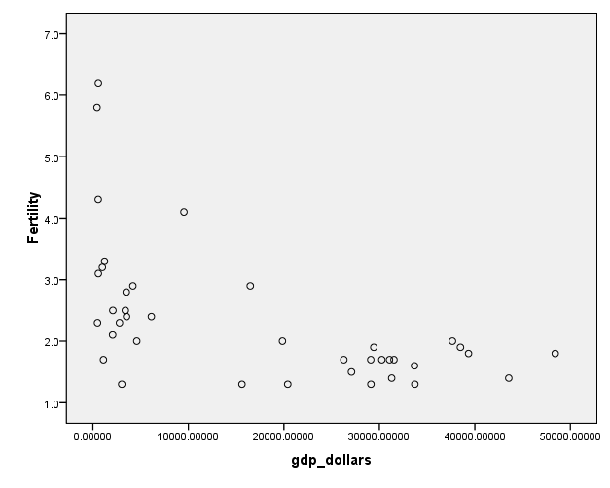

Slide 36
Example: Survey in Alachua County, Florida, on predictors of mental health
(data for n = 40 on p. 327 of text and at www.stat.ufl.edu/~aa/social/data.html)
y = measure of mental impairment (incorporates various dimensions of psychiatric symptoms, including aspects of depression and anxiety)
(min = 17, max = 41, mean = 27, s = 5)
x = life events score (events range from severe personal disruptions such as death in family, extramarital affair, to less severe events such as new job, birth of child, moving)
(min = 3, max = 97, mean = 44, s = 23)

Slide 37
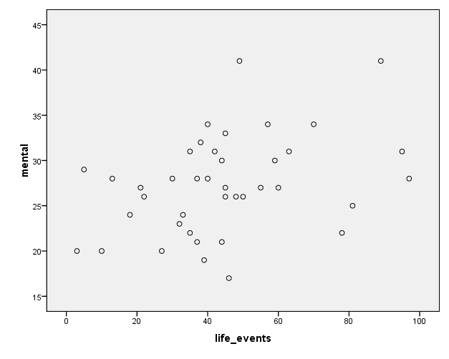

Slide 38
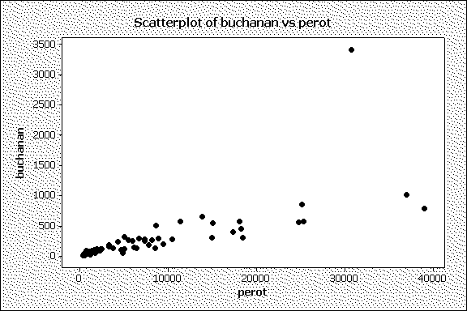
Bivariate data from 2000 Presidential election
Butterfly ballot, Palm Beach County, FL, text p.290

Slide 39
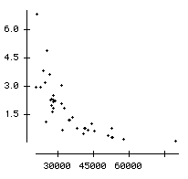
Example: The Massachusetts Lottery (data for 37 communities)
% income spent on lottery
Per capita income

Slide 40
Correlation describes strength of association
Falls between -1 and +1, with sign indicating direction of association (formula later in Chapter 9)
The larger the correlation in absolute value, the stronger the association (in terms of a straight line trend)
Examples: (positive or negative, how strong?)
Mental impairment and life events, correlation =
GDP and fertility, correlation =
GDP and percent using Internet, correlation =

Slide 41
Correlation describes strength of association
Falls between -1 and +1, with sign indicating direction of association
Examples: (positive or negative, how strong?)
Mental impairment and life events, correlation = 0.37
GDP and fertility, correlation = - 0.56
GDP and percent using Internet, correlation = 0.89

Slide 42
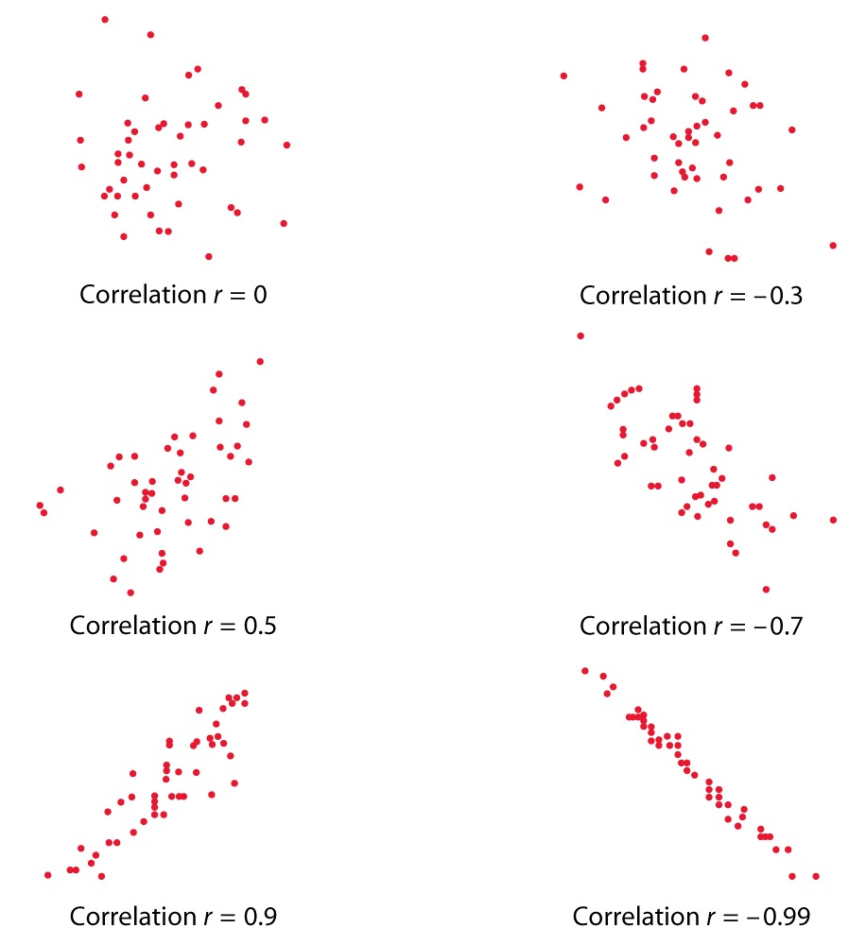

Slide 43
Regression analysis gives line predicting y using x
Example:
y = mental impairment, x = life events
Predicted y = 23.3 + 0.09x
e.g., at x = 0, predicted y =
at x = 100, predicted y =

Slide 44
Regression analysis gives line predicting y using x
Example:
y = mental impairment, x = life events
Predicted y = 23.3 + 0.09x
e.g., at x = 0, predicted y = 23.3
at x = 100, predicted y = 23.3 + 0.09(100) = 32.3
Inference questions for later chapters?
(i.e., what can we conclude about the population?)

Slide 45
Example: student survey y = college GPA, x = high school GPA (data at www.stat.ufl.edu/~aa/social/data.html)
What is the correlation?
What is the estimated regression equation?
We’ll see later in course the formulas for finding the correlation and the “best fitting” regression equation (with possibly several explanatory variables), but for now, try using software such as SPSS to find the answers.

Slide 46
Sample statistics / Population parameters
We distinguish between summaries of samples (statistics) and summaries of populations (parameters).
Common to denote statistics by Roman letters, parameters by Greek letters:
Population mean =μ, standard deviation = σ,
proportion  are parameters.
In practice, parameter values unknown, we make inferences about their values using sample statistics.

Slide 47
The sample mean estimates
the population mean μ (quantitative variable)
The sample standard deviation s estimates
the population standard deviation σ (quantitative variable)
A sample proportion p estimates
a population proportion  (categorical variable)

Slide 48
Questions?
What is the purpose of descriptive statistics?
Define the term "mean" in the context of descriptive statistics.
How is the median of a dataset calculated?
What does the mode of a dataset represent?
Explain the concept of "range" in descriptive statistics.
What is a "standard deviation" and what does it indicate about a dataset?
How is variance related to standard deviation?
Describe what a histogram is used for in descriptive statistics.
What is a "box plot" and what information does it convey?
Explain the difference between a population and a sample in statistics.

Slide 49
References
Books:
Hastie, Trevor, et al., The elements of statistical learning. Vol. 2. No. 1. New York: Publisher: Springer, Edition: Second Edition (2009), ISBN: 978-0387848570
Practical Statistics for Data Scientists: 50 Essential Concepts, Authors: Peter Bruce, et al, Publisher: O'Reilly Media, Edition: Second Edition (2020), ISBN: 978-1492072942
Research Papers:
Carmichael, Iain, and J. S. Marron. "Data science vs. statistics: two cultures?." Japanese Journal of Statistics and Data Science 1.1 (2018): 117-138.
Hardin, Johanna, et al. "Data science in statistics curricula: Preparing students to “think with data”." The American Statistician 69.4 (2015): 343-353.
Websites:
https://365datascience.com/resources-center/course-notes/statistics/
https://www.geeksforgeeks.org/7-basic-statistics-concepts-for-data-science/
Videos:
https://www.youtube.com/playlist?list=PLZ2ps__7DhBYrMs3zybOqr1DzMFCX49xG

Slide 50
THANK YOU
For queries
Email: madan.e13485@cumail.in

